Slide 1
The Sound of Systems
Eleanor Campbell, Shane Dicks, Miles Schneider, and John DeArmon
Notes:
2.5 minutes for each person.

Slide 2
“So what’s the problem?
“Why do we continue to make so little progress in addressing our many very pressing social concerns?” -Richmond (2010)
Problem: Lack of Systems Education in Society at Large
Goal: Spread an Intuitive Knowledge of Systems

Slide 3
Why Music?
“Words have to find a man’s mind before they can touch his heart. And, some men’s minds are woeful small targets. Music touches their hearts directly, no matter how small or stubborn the mind of the man who listens.”
-Patrick Rothfuss, Name of the Wind

Slide 4
Fields of Musical Systems Composition:
Our Journey
Move Follow | Play a Note
Move Oppose | Reactive/Responsive Melodies
Reflective | Looping Responsive Notes Together
Generative | Generation of Music
Notes:
End at 2:30

Slide 5
Mental Model of System Goal
Properties of our Ideal
Music Generator
Patches we know how to make, which do something we want
Desired effects we don’t know how to program
Patches we don’t know how to make or aren’t desired
All Possible PD Patches
Notes:
(John)

Slide 6
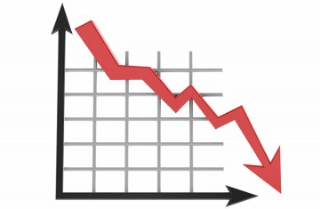
Suprasystem-level
Time spent:
– Building group vision
– Learning PD
– Writing patches
+
Time until presentation
-
-
Time at work
-
-
TIME ITSELF!
Time spent on other classes & assignments
Time for personal needs
Notes:
(John)

Slide 7
Model of System Operations
(Arrows indicate information flows)
Video
Tutorials
Experimental
Patches
PD Documentation
Eleanor
John
Miles
Shane
Notes:
(John) End at 5 min

Slide 8
PureData Basics
Based on Max/MSP
Visual programming
Using spatial metaphor
Written with music and video applications in mind
Notes:
End at 7:30
(miles)

Slide 9
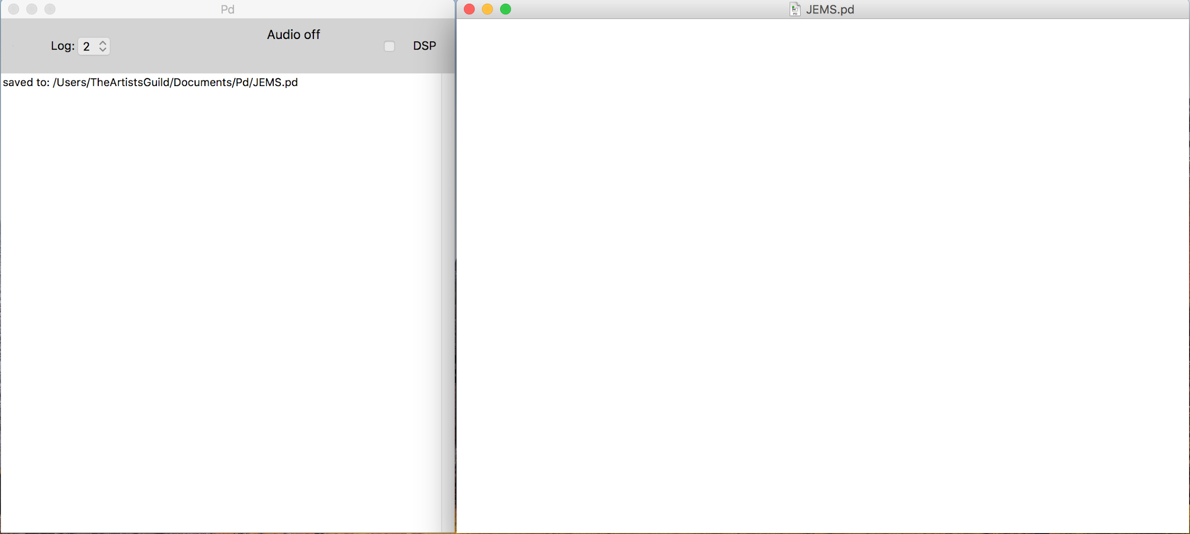

Slide 10
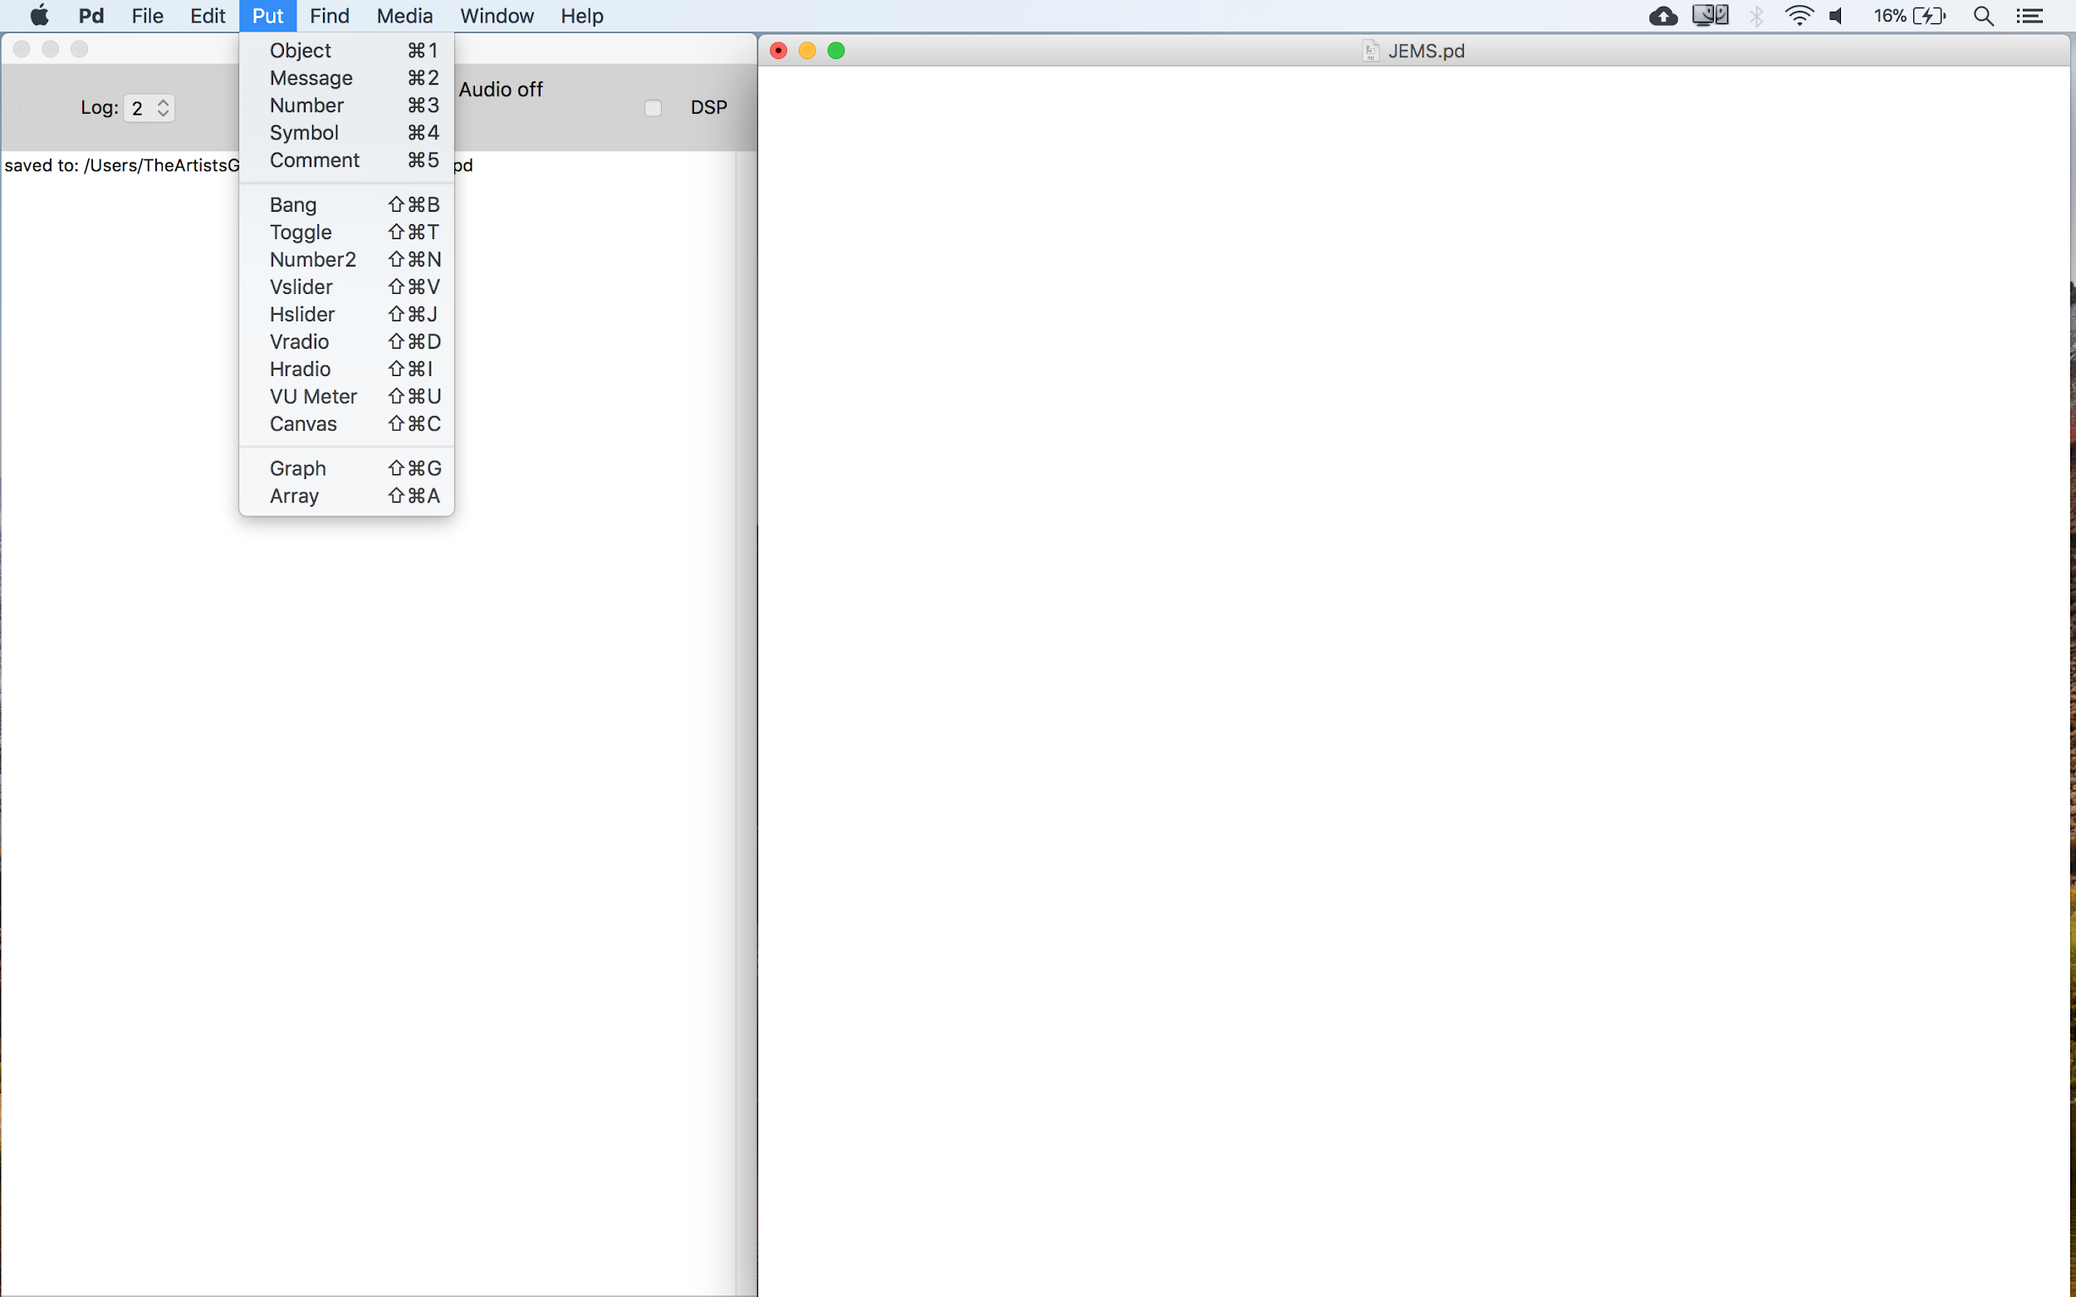

Slide 11
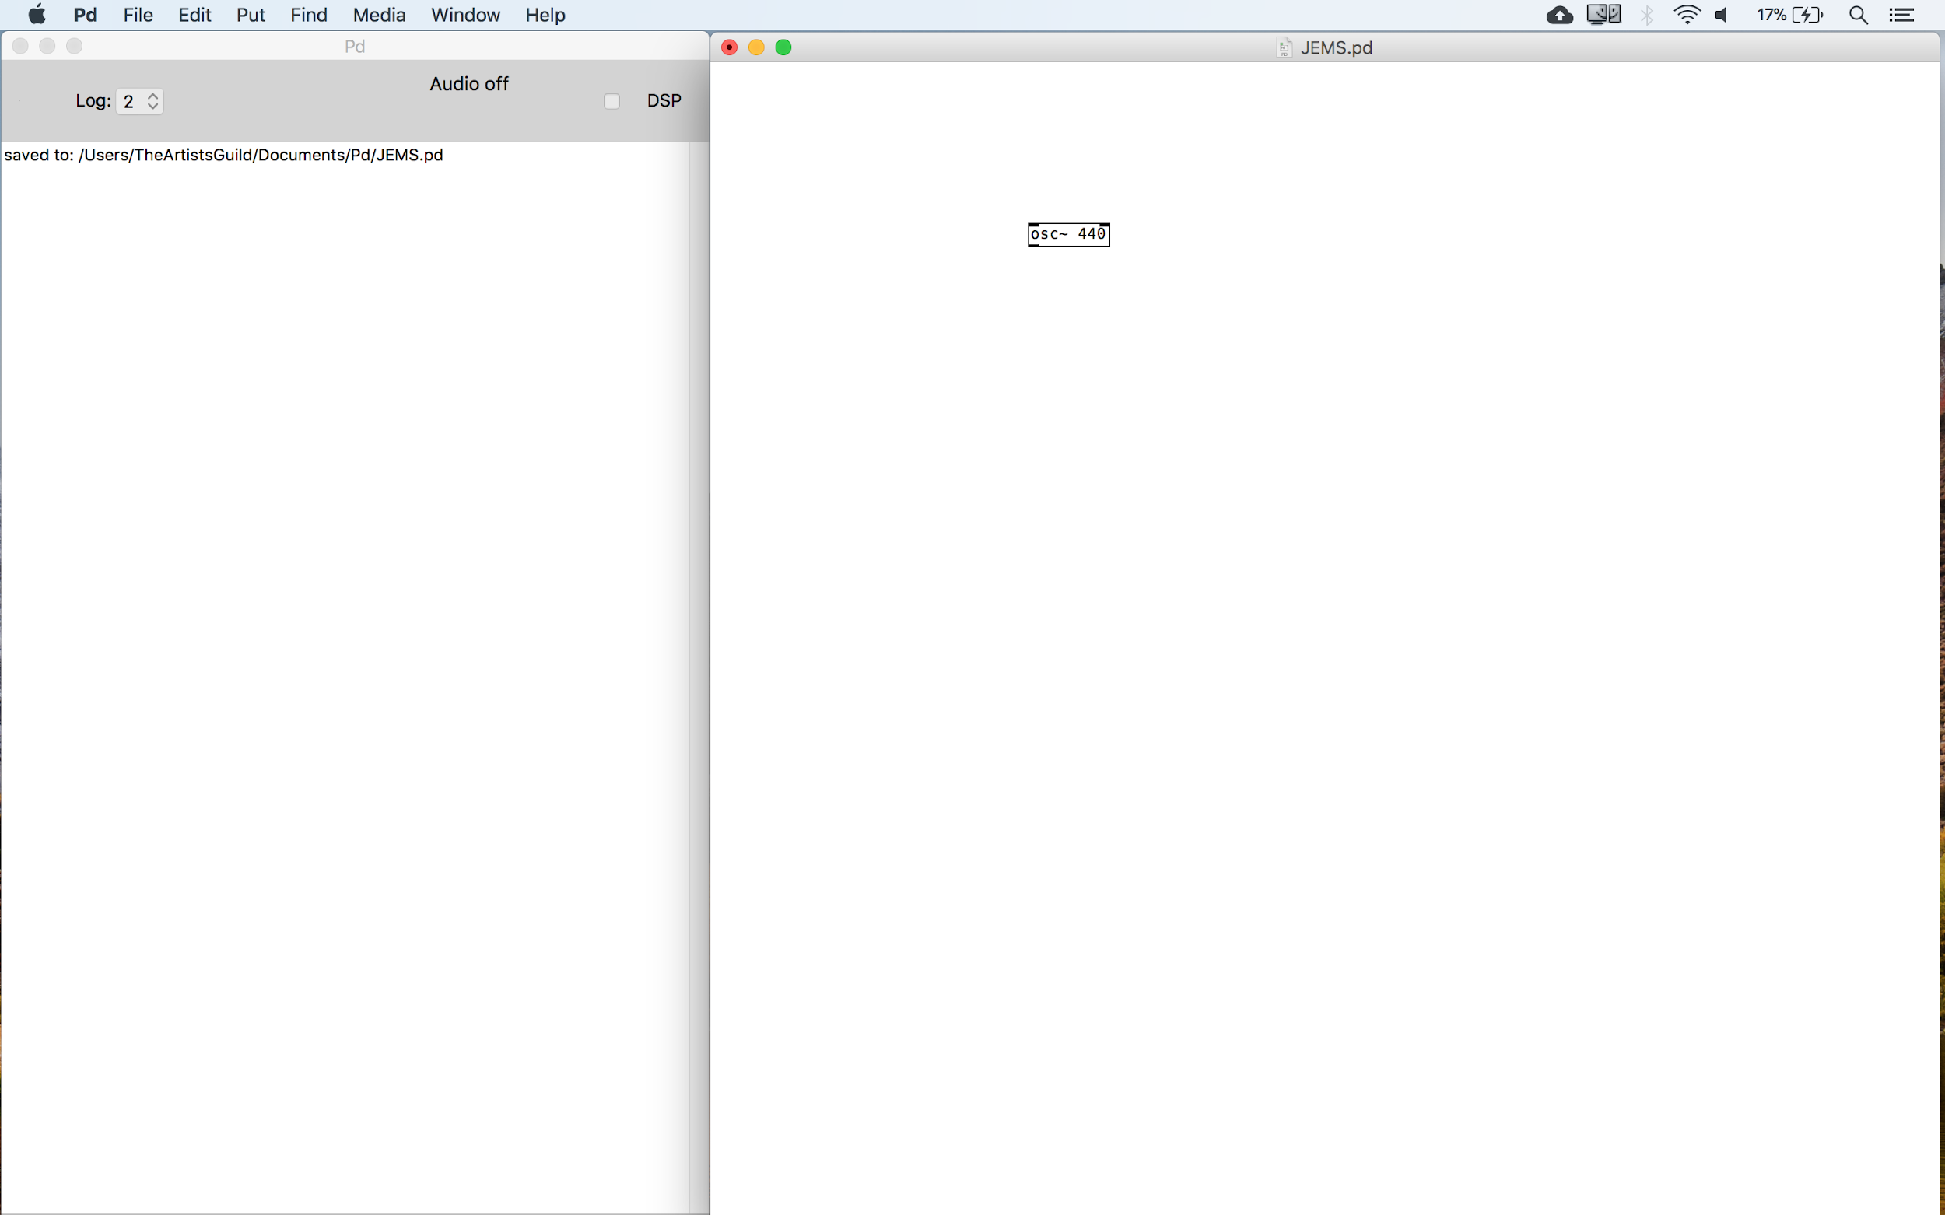

Slide 12
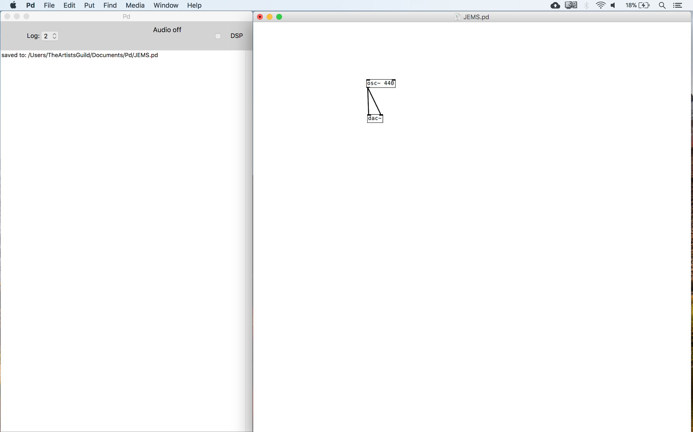

Slide 13
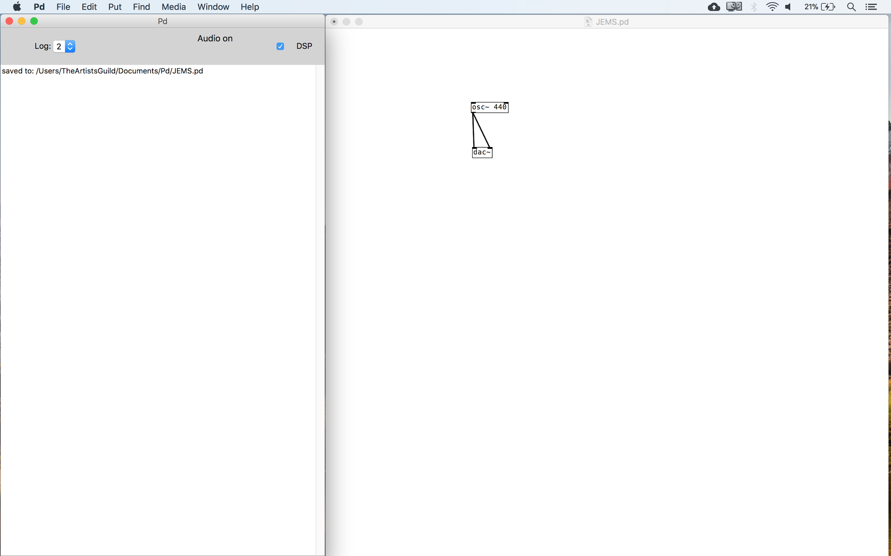

Slide 14
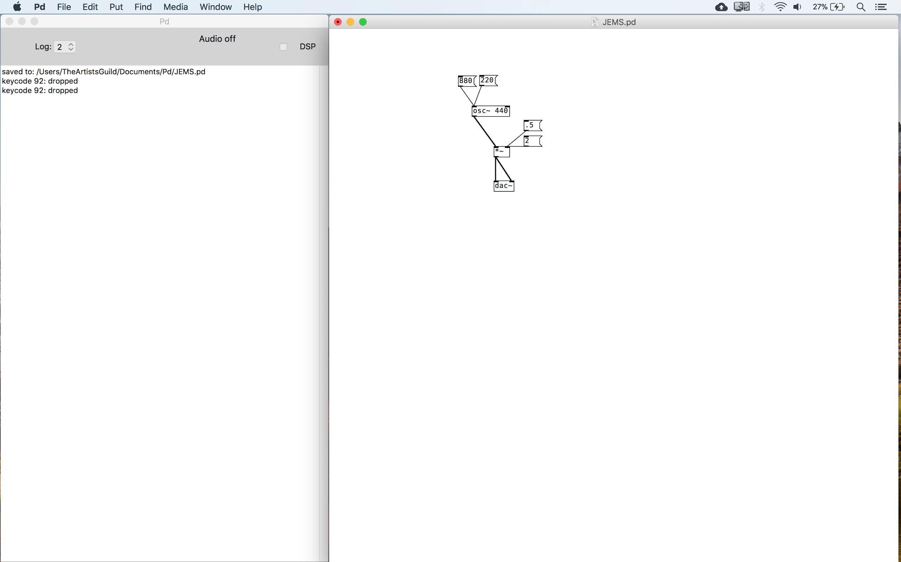

Slide 15
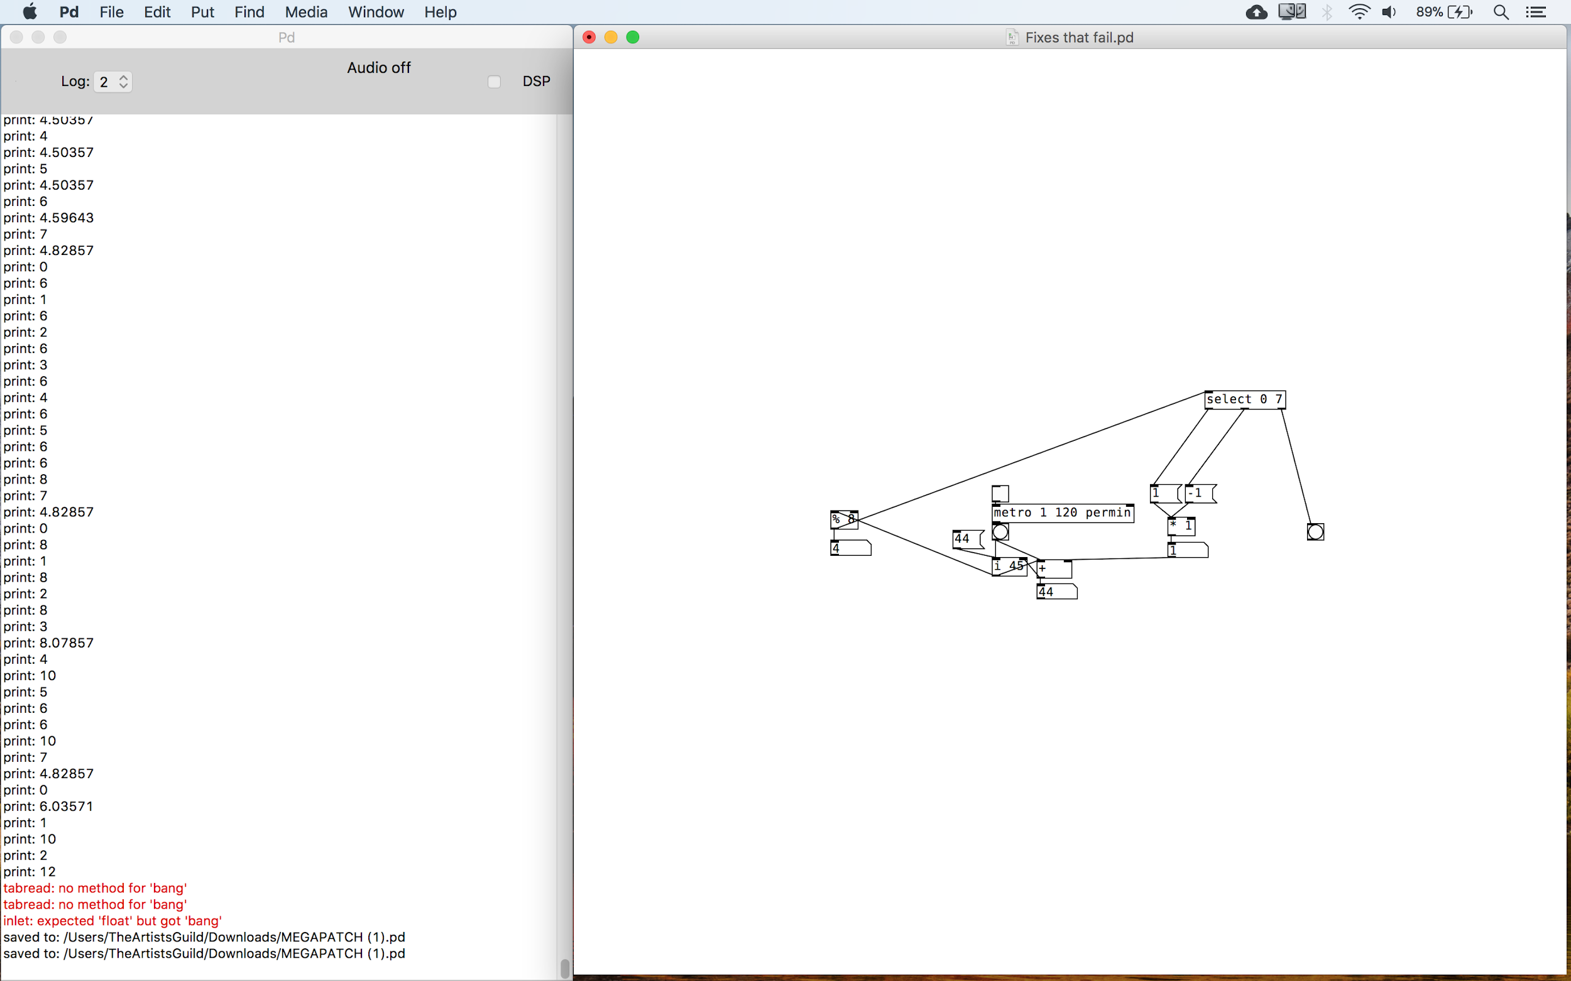

Slide 16
Patch Tour
Patch Goals
Human interface
Independent, Reflective Elements
Message Passing and Reactivity
Global Variables
Emergence and Complexity
Patch Reality
Human Interface
Independent Elements, one reflective
Global Variables
Limited communication between elements
Variation, but no real complexity
Notes:
End at 10:00

Slide 17
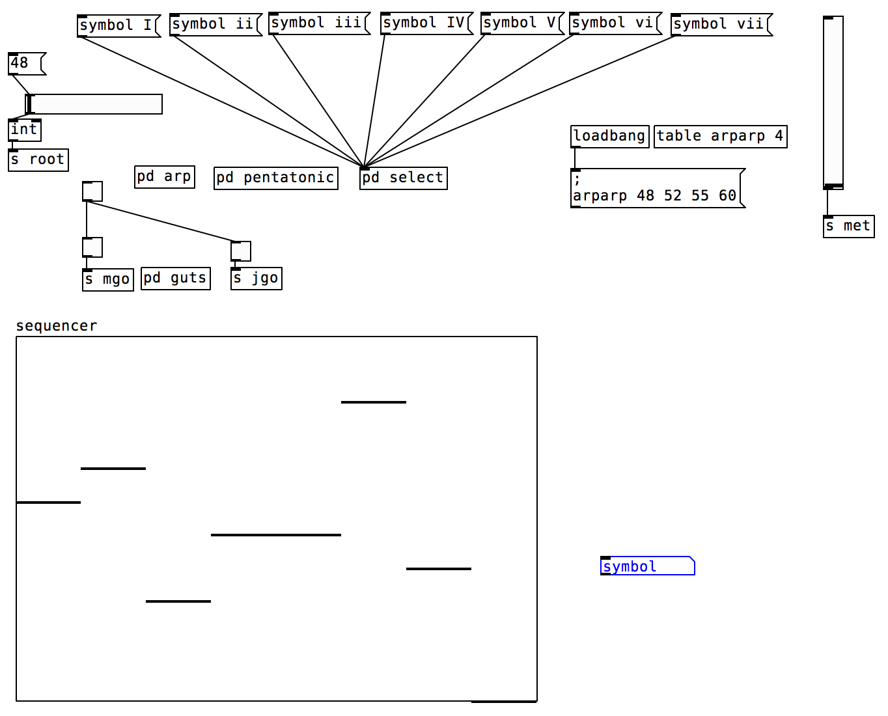
Patch Tour
Notes:
End at 10:00

Slide 18
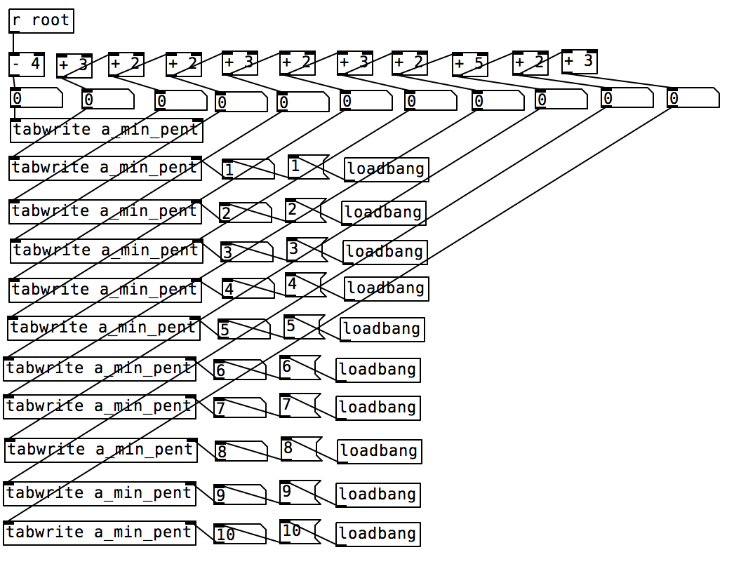
Patch Tour
Notes:
End at 10:00

Slide 19
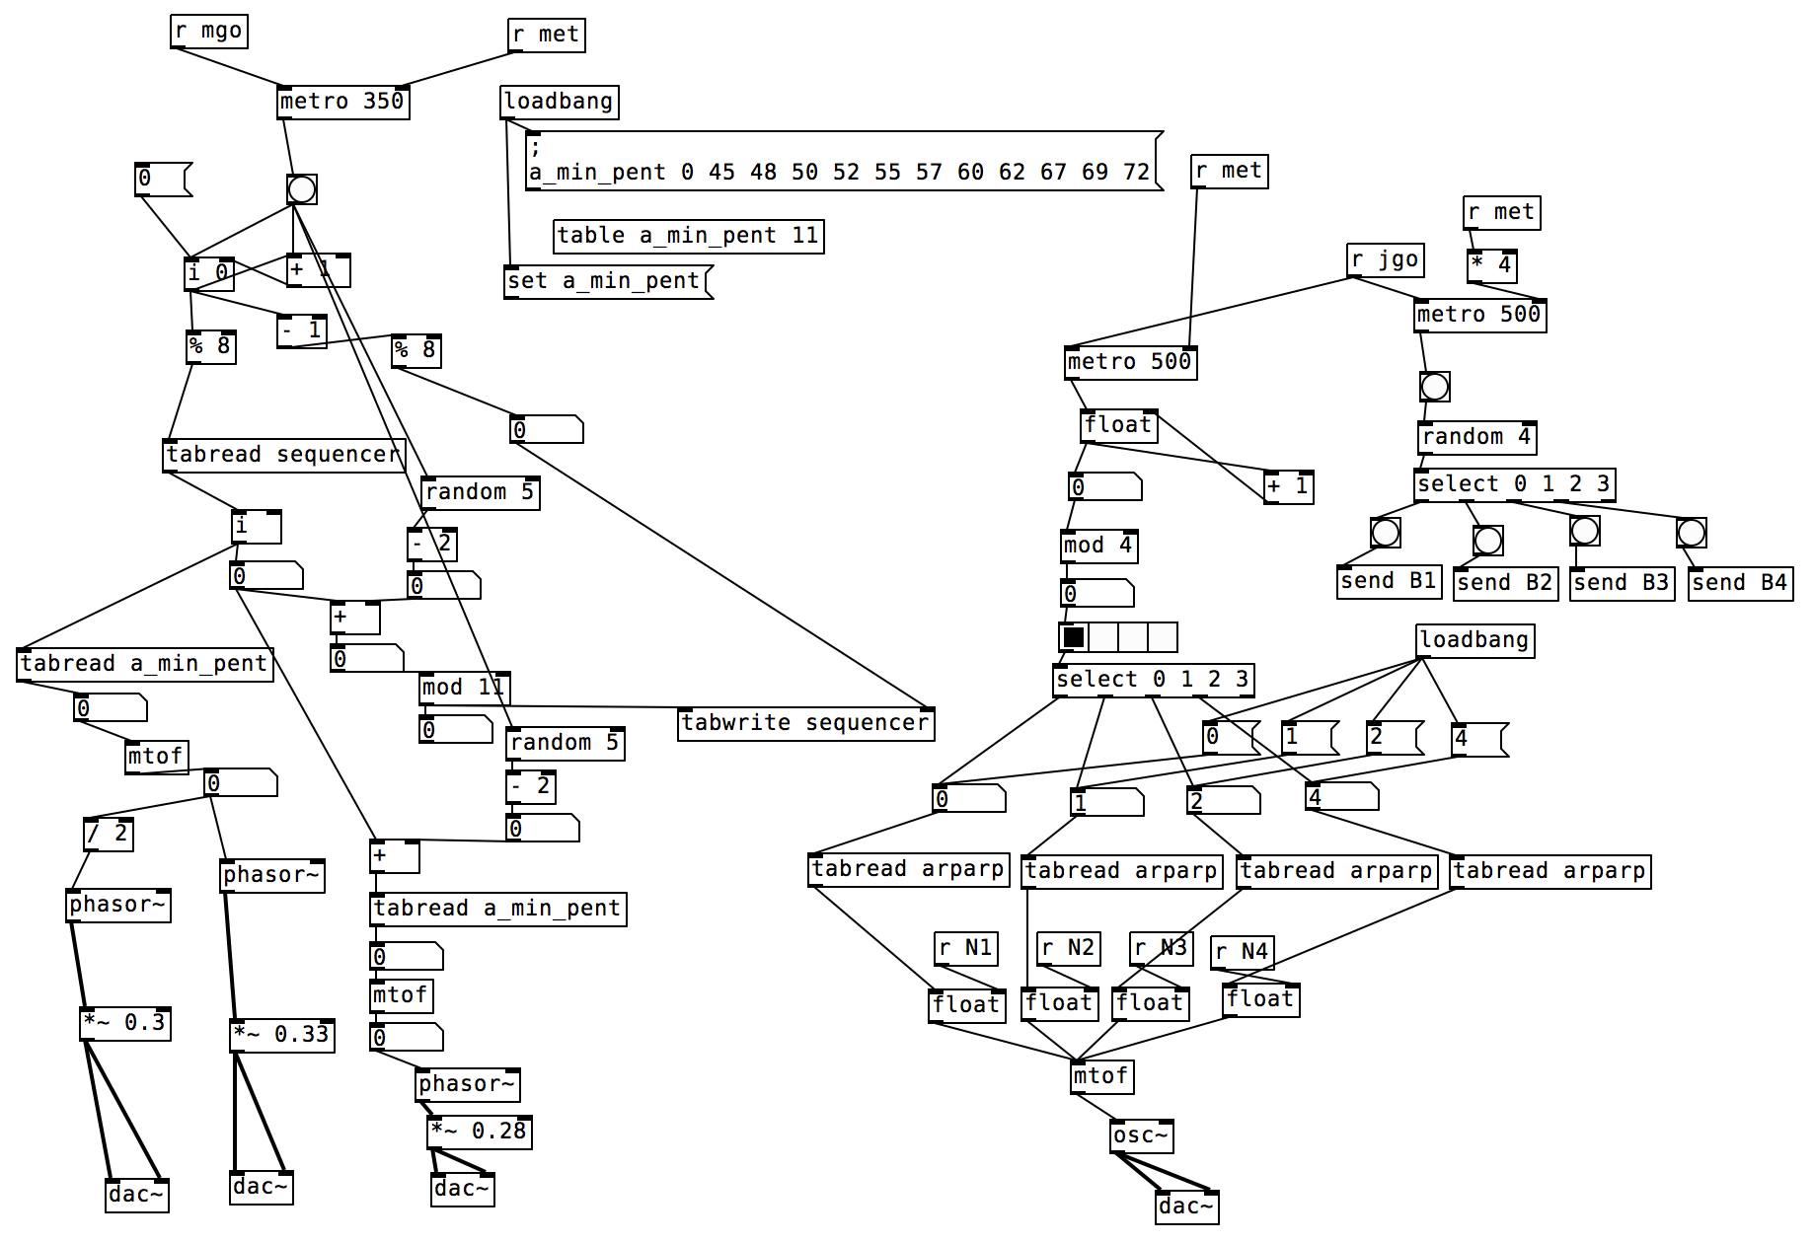
Patch Tour
Notes:
End at 10:00

Slide 20
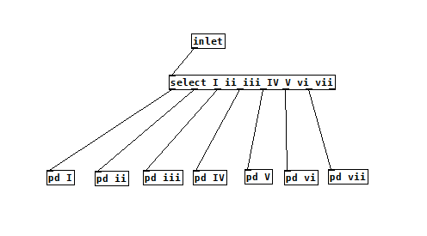
Patch Tour
Notes:
End at 10:00

Slide 21
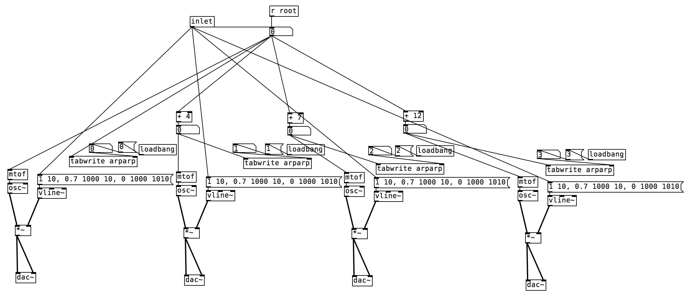
Patch Tour
Notes:
End at 10:00

Slide 22
Play time + Questions

Slide 23
Musical Lendaris
 | Rhythm | Lyrics | Melody | Harmony
Song
Verse
Phrase
Note

